Slide 2
UNIT 3
Backward Propagation Algorithm: Derivatives and Gradients, Common Properties of Derivatives, Derivative of Activation Function, Gradient of Loss Function, Gradient of Fully Connected Layer, Chain Rule, Back Propagation Algorithm, Hands-On Optimization of Himmelblau, Hands-On Back Propagation Algorithm, HandsOn Handwritten Digital Image Recognition.
Keras Advanced API: Common Functional Modules, Model Configuration, Training, and Testing, Model Configuration, Model Saving and Loading, Custom Network, Model Zoo, Metrics, Hands-On Accuracy Metric, Visualization.
Overfitting: Model Capacity, Overfitting and Underfitting, Dataset Division, Model Design, Regularization, Dropout, Data Augmentation, Hands-On Overfitting.

Slide 4
Backward Propagation Algorithm
Derivatives and Gradients
Common Properties of Derivatives
Derivative of Activation Function

Slide 5

Derivatives and Gradients
Derivative is defined as the limit of the ratio of the increment Δy of the function output value to the increment Δx of the independent variable x when the
independent variable x produces a slight disturbance Δx as Δx approaches to zero:

Slide 6



Slide 7


For univariate functions, the derivative is
written as
For the partial derivative of the multivariate function, it is recorded as
Partial derivatives are special cases of derivatives and have no direction.

Slide 8
Consider a neural network model that is essentially a multivariate function, such as a weight matrix W of shape [784, 256], which contains a connection weight of 784 × 256, and we need to ask for a partial derivative of 784 × 256.
It should be noted that in mathematical expression,
the independent variables to be discussed are generally recorded as x, but in neural networks, they are generally used to represent inputs, such as pictures, text, and voice data.

Slide 9


The independent variables of the network
are network parameter sets
When the gradient descent algorithm is used to optimize the network, all partial derivatives of the network need to be requested.
Therefore, we are also concerned about the derivative of the error function L output along the direction of the
independent variable( θ)

Slide 10


Write all partial derivatives of
the function in vector form:
The gradient descent algorithm can be updated in the form of a vector:
η is learning rate. The gradient descent algorithm is generally to find the minimum value of the function L.

Slide 11

sometimes it is also desirable to solve the maximum value of the function, which need to update the
gradient in the following way:
This update method is called the gradient ascent algorithm.
The gradient descent algorithm and the gradient ascent algorithm are the same in principle.
One is to update in the opposite direction of the gradient,
and the other is to update in the direction of the gradient. Both need to solve partial derivatives.

Slide 12

Here, the vector
is called the gradient of the function, which is composed of all partial derivatives and represents the direction.
The direction of the gradient indicates the direction in which the function value rises fastest, and the reverse of the gradient indicates the direction in which the function value decreases fastest.

Slide 13
Common Properties of Derivatives

Slide 14
Common Derivatives

Slide 15
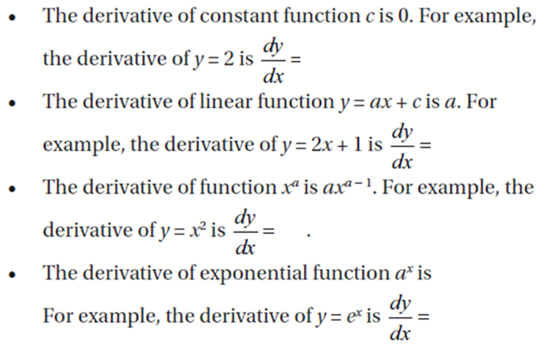

Slide 16
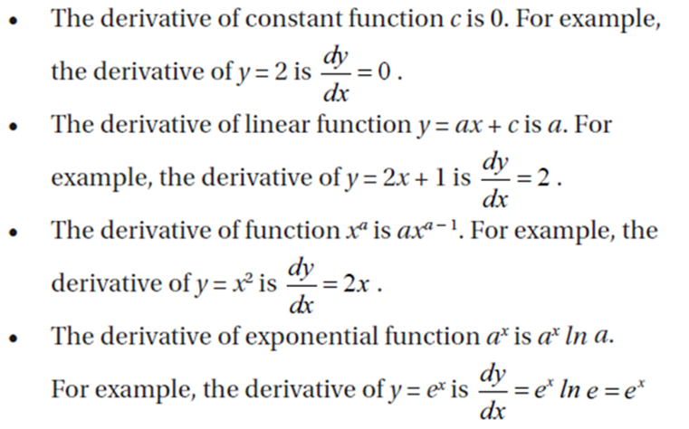

Slide 17
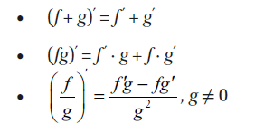
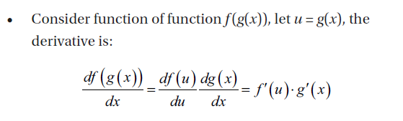
Common Property of Derivatives

Slide 18
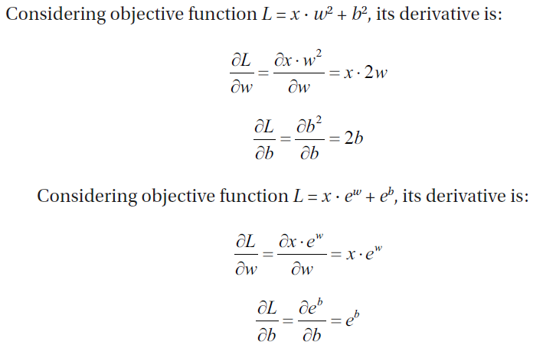
Hands-On Derivative Finding

Slide 19
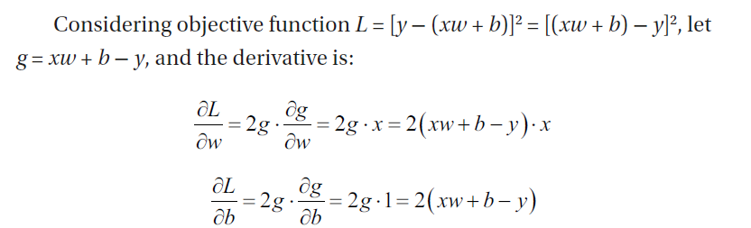
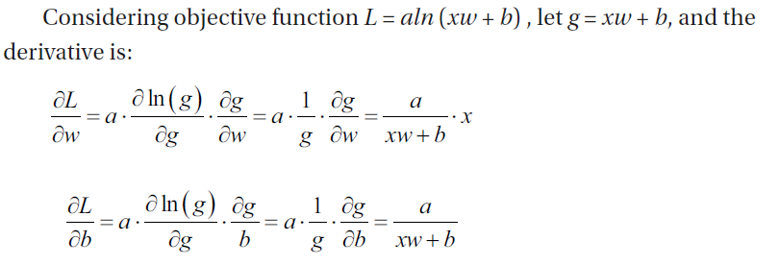

Slide 20
Derivative of Activation Function
Derivative of Sigmoid Function
Derivative of ReLU Function
Derivative of LeakyReLU Function
Derivative of Tanh Function

Slide 21
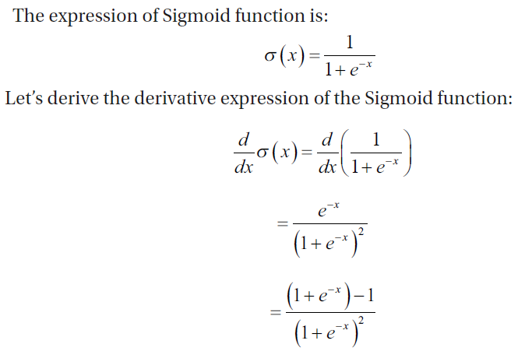
Derivative of Sigmoid Function

Slide 22
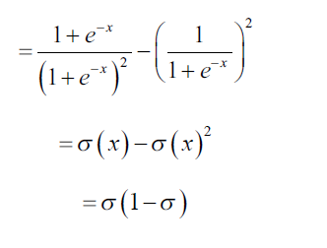
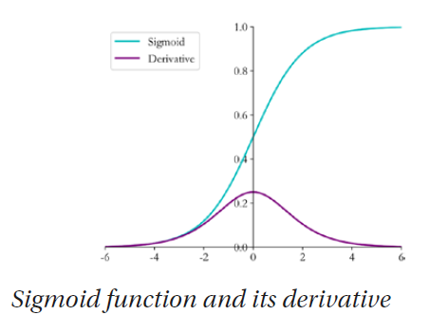

Slide 23
import numpy as np # import numpy library
def sigmoid(x): # implement sigmoid function
return 1 / (1 + np.exp(-x))
def derivative(x): # calculate derivative of sigmoid
# Using the derived expression of the derivatives
return sigmoid(x)*(1-sigmoid(x))

Slide 24
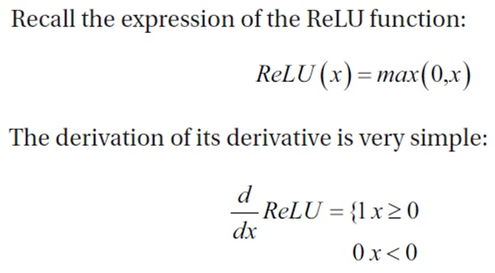
Derivative of ReLU Function

Slide 25
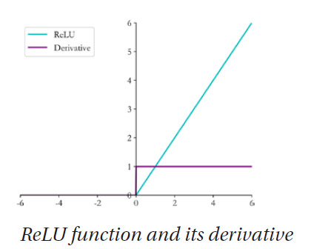

Slide 26
def derivative(x): # Derivative of ReLU
d = np.array(x, copy=True)
d[x < 0] = 0 #if condition is true , 0 is copied into d
d[x >= 0] = 1
return d

Slide 27
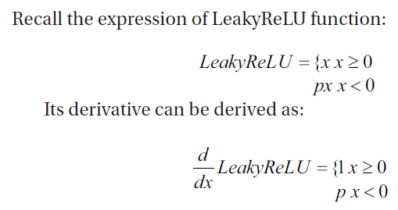
Derivative of LeakyReLU Function

Slide 28
It’s different from the ReLU function because when x is less than zero, the derivative value of the LeakyReLU function is not 0, but a constant p, which is generally set to a smaller value, such as 0.01 or 0.02.

Slide 29
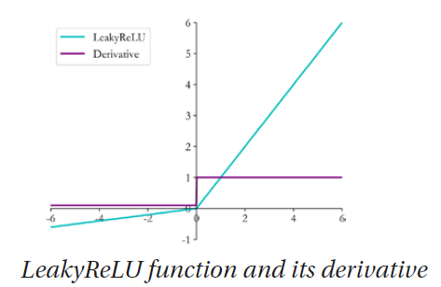

Slide 30
CODE
def derivative(x, p):
dx = np.ones_like(x) # initialize a vector with 1
dx[x < 0] = p # set negative part to p
return dx
Notes:
# p is the slope of negative part of LeakyReLU

Slide 31
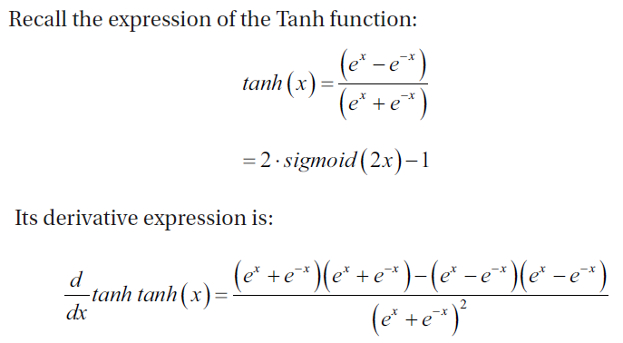
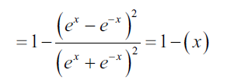
Derivative of Tanh Function

Slide 32
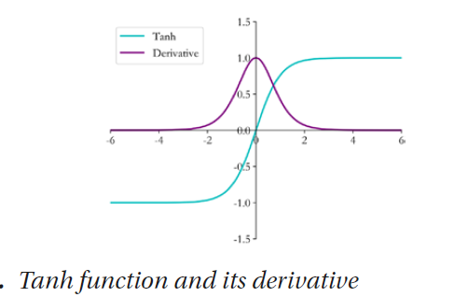

Slide 33
In Numpy, the derivative of the Tanh function is implemented through
the Sigmoid function as follows:
CODE:
def sigmoid(x): # sigmoid function
return 1 / (1 + np.exp(-x))
def tanh(x): # tanh function
return 2*sigmoid(2*x) - 1
def derivative(x): # derivative of tanh
return 1-tanh(x)**2

Slide 34
Error Calculation
Common error functions are
Mean square error,
cross-entropy,
KL divergence
hinge loss.

